Slide 1

C# History
C# is pronounced as "C-Sharp“.
It is an object-oriented programming language provided by Microsoft that runs on .Net Framework.
Anders Hejlsberg is known as the founder of C# language.
C# has evolved much since their first release in the year 2002.
It is based on C++ and Java, but it has many additional extensions used to perform component oriented programming approach.

Slide 2
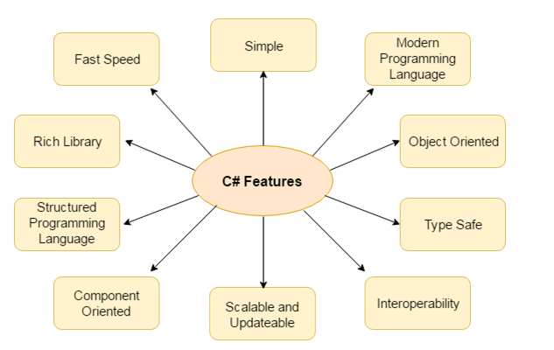
C# Features
Simple
Modern programming language
Object oriented
Type safe
Interoperability
Scalable and Updateable
Component oriented
Structured programming language
Rich Library
Fast speed

Slide 3
Next…
Basic Program Structure

